Slide 1
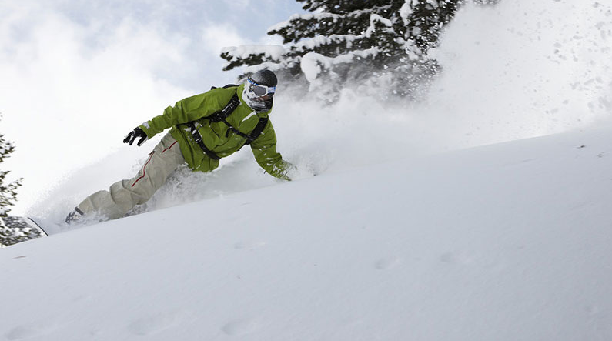
Big Mountain Resort
CALEB SMOTHERMAN

Slide 2
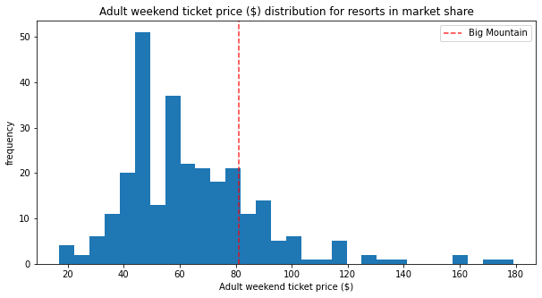
Issue: Big Mountain is underpricing their tickets.
Recommendations: 1) Increase ticket prices to around $90.
2) Increase the vertical drop feature of the resort by opening an additional run lower down the mountain and add 2 acres of additional snow-making coverage. 3) Close up to 2 less popular runs to help reduce operating costs.
Adult weekend ticket price ($) distribution for resort in market share
 | Current Price
 | Recommended Price

Slide 3
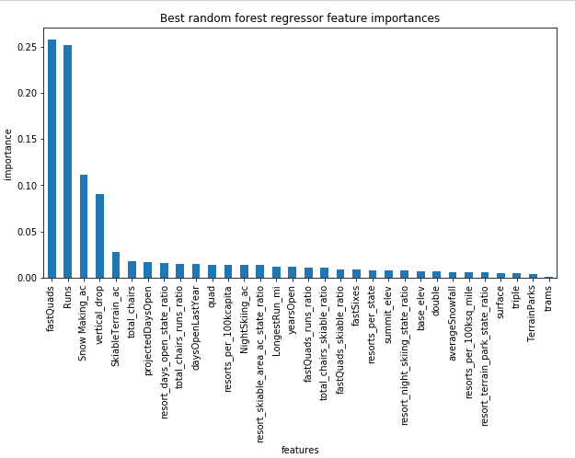
Important Features detected by a Random Forests Model
Random Forest Regressor feature importance
Fast Quads*
Runs
Snow Making
Vertical Drop
*Big Mountain has a high number of Fast Quads for when compared to the rest of the market.

Slide 4
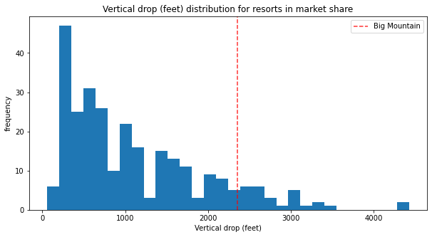
Justification for Increasing Vertical Drop: Vertical drop is an important feature and is directly connected to another important feature – Runs.
Suggestion: Increasing the vertical drop by adding a run to a point 150 feet lower down, installing an additional chair lift to bring skiers back up, and adding 2 acres of snow making cover will support an increase in ticket price by $9.88
 | Current Vert. Drop
 | After increase
Over the season, this could be expected to increase revenue by
$17,290,000

Slide 5
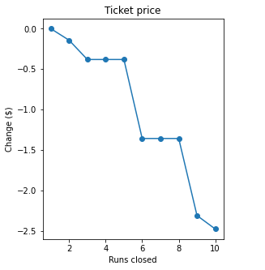
Closing a run:
The closing of 1 run does not affect our price or revenue – but can help lower operational costs.
Closing 2 or 3 runs will decrease revenue – but there would be no impact closing 3, 4 or 5 runs.
Note: Because our current suggestion recommends the opening of a new run to allow for an increased vertical drop, we could potentially close 2 runs without impacting the ticket price.
1
2
3
4
5
6
7
8
9

Slide 6
Conclusion
A Random Forest Model supports an increase of our ticket price to $90.88 by increasing our vertical drop with the installation of another chair lift and additional snow-making coverage.
Closing 1-2 runs can help decrease operational costs.
By raising our ticket prices and engaging in a marketing campaign to highlight our new facilities, we could see an excellent return on investment. Considering those upgrades will take time, we can simply close a run now to immediately lower operating expenses.
By prioritizing our feature upgrades based on their time-to-complete, we can periodically increase our ticket prices as those features become available.

